Slide 1
Discrete Mathematics
Dr. Han Huang
South China University of Technology
1

Slide 2
Chapter 1. Logic and Proof, Sets, and Function
Nested Quantifiers
Section 1.4
2

Slide 3
Contents
1
Translating Statements Involving Nested Quantifiers
2
Translating Statements Into Logical Expressions
3
Negating Nested Quantifiers
4
The Order of Quantifiers
3

Slide 4
Translating Statements Involving Nested Quantifiers
4

Slide 5
Example 1
5
∀x ∀y (x + y = y + x)
says that x + y = y + x for all real number x and y.
∀x ∃y (x + y = 0)
says that for every real number x there is real number y such that x + y = 0.

Slide 6
Example 2
6
∀x ∀y ((x >0) ∧ (y <0) → (xy<0))
The statement says that for every real number x and y, if x >0 and y <0, then xy<0.
“The product of a positive real number and a negative real number is a negative real number.”

Slide 7
Example 3
∀x (C(x) ∨ ∃y (C(y) ∧ F(x, y))), where C(x) is “x has a computer,” F(x, y) is “x and y are friends”, and the universe of discourse for both x and y consists of all students in your school.
Every student in your school has a computer or has a friend who has a computer.
7

Slide 8
Example 4
∀x ∀y ∀z
((F(x, y) ∧ F(x, z) ∧ (y≠ z)) → ¬ F(y, z))
where F(a, b) means a and b are friends and the universe of discourse for x, y and z consists of all students in your school.
For all students, none of their friends are also friends with each other.
8

Slide 9
Translating Statements Into Logical Expressions
9

Slide 10
Example 5
prenex formulae
10
F(x) represents “x is female”
P(x) represents “x is a parent”
M(x, y) represents “x is the mother of y”
“If a person is female and is a parent, then this person is someone’s mother”
∀x ((F(x) ∧ P(x)) → ∃y M(x, y))
∀x ∃y ((F(x) ∧ P(x)) → M(x, y))

Slide 11
Example 6
B(x, y) represents “y is the best friend of x”.
∀x ∃y (B(x, y) ∧ ∀z ((z ≠ y) → ¬ B(x, z)))
“Everyone has exactly one best friend.”
11

Slide 12
Example 7
12
P(w, f) represents “w has taken f ”
Q(f, a) represents “f is a flight on a ”
R(w, f, a) represents “w has taken f on a ”
“There is a woman who has taken a flight on every airline in the world.”
∃w ∀a ∃f (P(w, f) ∧ Q(f, a) )
∃w ∀a ∃f R(w, f, a)

Slide 13
Example 8-9
13
“The sum of two positive integers is positive.”
∀x ∀y ((x > 0) ∧ (y > 0) → (x + y >0 ))
“Every real number except zero has a multiplicative inverse.”
∀x ((x ≠ 0) → ∃y ( xy = 1 ))

Slide 14
Negating Nested Quantifiers
14

Slide 15
Example 11
15
∀x ∃y (xy = 1)
¬ ∀x ∃y (xy = 1)
⇔ ∃x ¬ ∃y (xy = 1)
⇔ ∃x ∀y ¬ (xy = 1)
⇔ ∃x ∀y ( xy≠ 1 )

Slide 16
Example 12
16
What is the negation of the logic expression of Example 7.
∃w ∀a ∃f (P(w, f) ∧ Q(f, a) ) Example 7
¬ ∃w ∀a ∃f (P(w, f) ∧ Q(f, a) )
⇔ ∀w ¬ ∀a ∃f (P(w, f) ∧ Q(f, a) )
⇔ ∀w ∃ a ¬ ∃f (P(w, f) ∧ Q(f, a) )
⇔ ∀w ∃ a ∀ f ¬ (P(w, f) ∧ Q(f, a) )
⇔ ∀w ∃ a ∀ f ( ¬ P(w, f) ∨ ¬ Q(f, a) )

Slide 17
Example 10 and Example 13
Logic expression of the definition of a limit using quantifiers.
Limx→a f ( x ) = L
∀ε>0 ∃δ >0 ∀x >0 (0<|x–a|<δ) → | f (x)–L|<ε)
Limx→a f ( x ) ≠ L
¬∀ε>0 ∃δ >0 ∀x >0 (0<|x–a|<δ) →|f (x)-L|<ε)
⇔∃ε >0 ∀δ >0 ∃x >0 ¬((0<|x–a|<δ)→|f (x)-L|<ε)
⇔∃ε >0 ∀δ >0 ∃x >0 ¬(¬(0<|x–a|<δ) ∨ |f (x)-L|<ε)
⇔∃ε >0 ∀δ >0 ∃x >0 (0<|x–a|<δ) ∧ ¬|f (x)-L|<ε)
⇔∃ε >0 ∀δ >0 ∃x >0 (0<|x–a|<δ) ∧ |f (x)-L|≥ε)
17

Slide 18
The Order of Quantifiers
18

Slide 19
Quantifications of Two Variables
19
∀x ∀y P(x,y) ∀y ∀x P(x,y)
When True? P(x,y) is true for every x,y.
When False? There is a pair x, y for which P(x, y) is false.
∀x ∃y P(x,y)
When True? For every x there is y for which P(x,y) is true.
When False? There is an x such that P(x,y) is false for every y.

Slide 20
Quantifications of Two Variables
∃x ∀y P(x,y)
When True? There is an x for which P(x,y) is true for every y.
When False? For every x there is a y for which P(x,y) is false.
∃x ∃y P(x,y) ∃y ∃x P(x,y)
When True? There is a pair x, y for which P(x, y) is true.
When False? P(x,y) is false for every x,y.
20

Slide 21
Example 16
Let Q(x,y,z) be the statement “x+y=z”
∀x ∀y ∃z Q(x,y,z)
“For all real numbers x and for all real numbers y there is a real number z such that x+y=z.” True
∃z ∀x ∀y Q(x,y,z) False
There is a real number z such that for all real numbers x and y it is true that x+y=z
21

Slide 22
命题符号化
22
(1)有些液体能够溶解任何金属
(2)任何金属均可溶解于某种液体之中

Slide 23
命题符号化
23
设P(x):x是液体,G(x):x是金属,R(x,y):x溶解y
(1)有些液体能够溶解任何金属
(∃ x) (P(x) ∧ (∀ y) (G(y) → R(x,y)))
(2)任何金属均可溶解于某种液体之中
(∀ x) (G(x) → (∃ y) (P(y) ∧ R(y,x)))

Slide 24
将命题翻译成自然语言
24
已给谓词如下：
P(x):x是素数
E(x):x是偶数
O(x):x是奇数
N(x,y):x可以整除y
（1） (∀x) (P(x)→ (∃y) (O(y)∧ N(y,x)))
（2） (∀x) (O(x)→ (∃y) (E(y)∧ ¬ N(y,x)))

Slide 25
将命题翻译成自然语言
25
（1） (∀x) (P(x)→ (∃y) (O(y)∧ N(y,x)))
对任意素数x，存在一个奇数y，使得y整除x
（2） (∀x) (O(x)→ (∃y) (E(y)∧ ¬ N(y,x)))
对任意一个奇数，都存在一个不整除它的偶数

Slide 26
Exercises
1. T (TRUE) or F (FALSE):
∃y∀x A(x,y)⇔ ∀x∃y A(x,y)
26

Slide 27
Exercises
1. T (TRUE) or F (FALSE):
∃y∀x A(x,y)⇔ ∀x∃y A(x,y)
FALSE
27

Slide 28
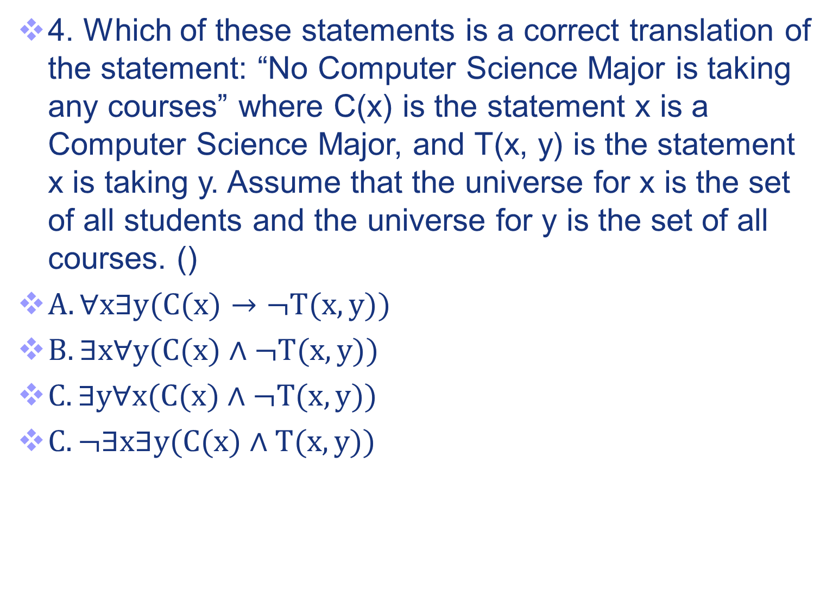
Exercises
2
D
.
28

Slide 29
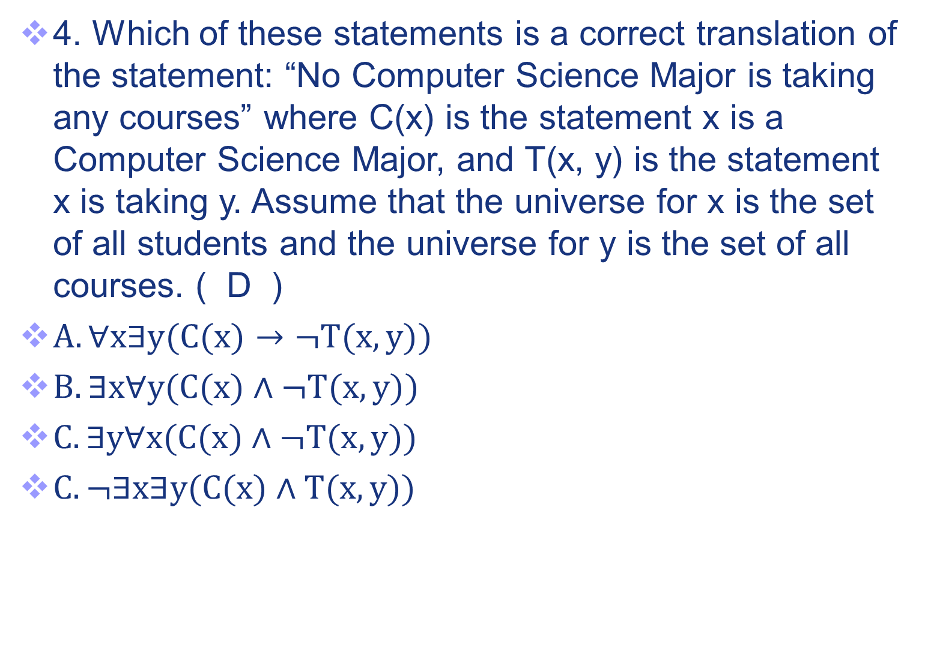
Exercises
2
D
.
29

Slide 30
Exercises
5. Which expression is right? ()
A、 ¬∃w∀a∃f(P(w, f) ∧ Q(f, a) ) ⇔
∀w∃a∀f( ¬ P(w, f) ∧ ¬ Q(f, a) )
B、 ¬∃w∀a∃f(P(w, f) ∧ Q(f, a) ) ⇔
∃w∀a∃f( ¬ P(w, f) ∨ ¬ Q(f, a) )
C、 ¬∃w∀a∃f (P(w, f) ∧ Q(f, a) ) ⇔
∀w∃a∀f( ¬ P(w, f) ∨ ¬ Q(f, a) )
D、 ¬∃w∀a ∃f (P(w, f) ∧ Q(f, a) ) ⇔
∃w∀a∃f( ¬ P(w, f) ∧ ¬ Q(f, a) )
3
30

Slide 31
Exercises
5. Which expression is right? (C)
A、 ¬∃w∀a∃f(P(w, f) ∧ Q(f, a) ) ⇔
∀w∃a∀f( ¬ P(w, f) ∧ ¬ Q(f, a) )
B、 ¬∃w∀a∃f(P(w, f) ∧ Q(f, a) ) ⇔
∃w∀a∃f( ¬ P(w, f) ∨ ¬ Q(f, a) )
C、 ¬∃w∀a∃f (P(w, f) ∧ Q(f, a) ) ⇔
∀w∃a∀f( ¬ P(w, f) ∨ ¬ Q(f, a) )
D、 ¬∃w∀a ∃f (P(w, f) ∧ Q(f, a) ) ⇔
∃w∀a∃f( ¬ P(w, f) ∧ ¬ Q(f, a) )
3
31

Slide 32
Exercises
4. Consider the statement ∀x∃y(M(x)→C(x,y)）where M(x) means x is a Mathematics Major, C(x,y) means x completed y , the universe for x consists of all students and the universe for y consists of all computer projects. Which of these statements is the English translation of the statement?
A. There is a computer project that every Mathematics Major completed.
B. Every Mathematics Major completed every computer project.
C. Every Mathematics Major completed at least one computer project.
D. Some Mathematics Major failed to complete every computer project.
32

Slide 33
Exercises
4. Consider the statement ∀x∃y(M(x)→C(x,y)）where M(x) means x is a Mathematics Major, C(x,y) means x completed y , the universe for x consists of all students and the universe for y consists of all computer projects. Which of these statements is the English translation of the statement? (C)
A. There is a computer project that every Mathematics Major completed.
B. Every Mathematics Major completed every computer project.
C. Every Mathematics Major completed at least one computer project.
D. Some Mathematics Major failed to complete every computer project.
33

Slide 34
Exercises
5. Suppose P(x): x is some kind of liquid, G(x): x is some kind of metal , R(x,y):x dissolves y.
Express the sentence “Some liquid can dissolve any metal” as a logical expression as_____________________
34

Slide 35
Exercises
5. Suppose P(x): x is some kind of liquid, G(x): x is some kind of metal , R(x,y):x dissolves y.
Express the sentence “Some liquid can dissolve any metal” as a logical expression as_____________________
(∃ x) (P(x) ∧ (∀ y) (G(y) → R(x,y)))
35

Slide 36

Exercises
6. Let $P(x)$ be the statements “x is the rational number”. Express the sentence “One rational number is bigger than all other rational numbers” in terms of $P(x)$, quantifiers, and logical connectives:
$$(∃x)(P(x)∧(∀y)(P(y)∧(¬x=y))→x>y)$$
36
36

Slide 37
Exercises
7. Let C(x): x is a computer. D(x): x is a peripheral equipment. P(x, y): x can communicate with y. Express the sentence “some computers can’t communicate with some peripheral equipment” as a logical expression as
37

Slide 38
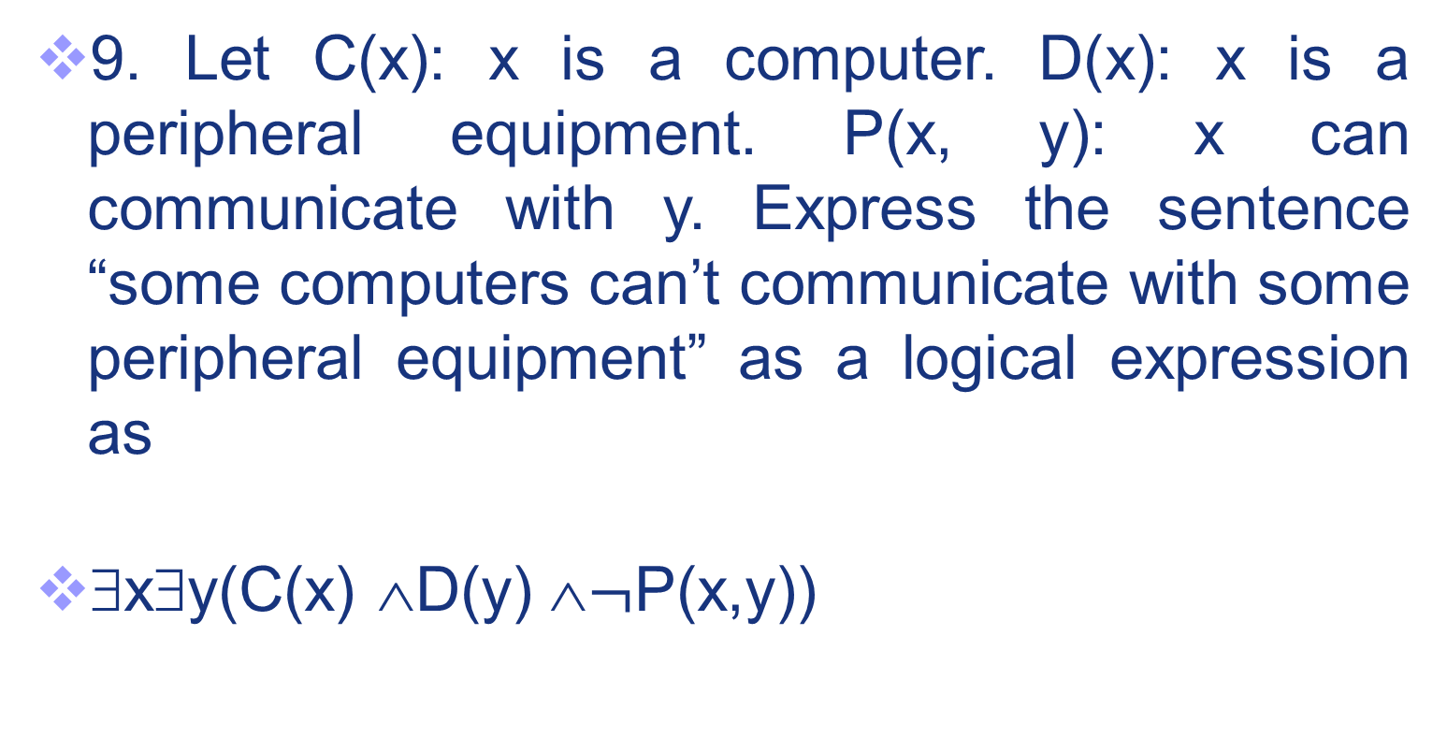
Exercises
7
38

Slide 39
Exercises
8. Let M(x, y) be “x has sent y an e-mail message” and T(x, y) be “x has telephoned y”, where the universe of discourse is a set of all students in your class. Use the predicate logic with quantifiers to express the following statement.
There is a student in your class who has not received an e-mail message from anyone else in the class or who has not been called by any other student in the class.
39

Slide 40
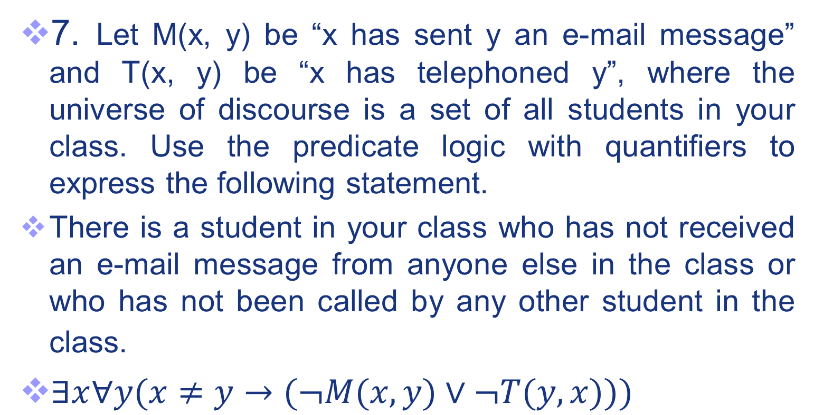
Exercises
8.
40

Slide 41
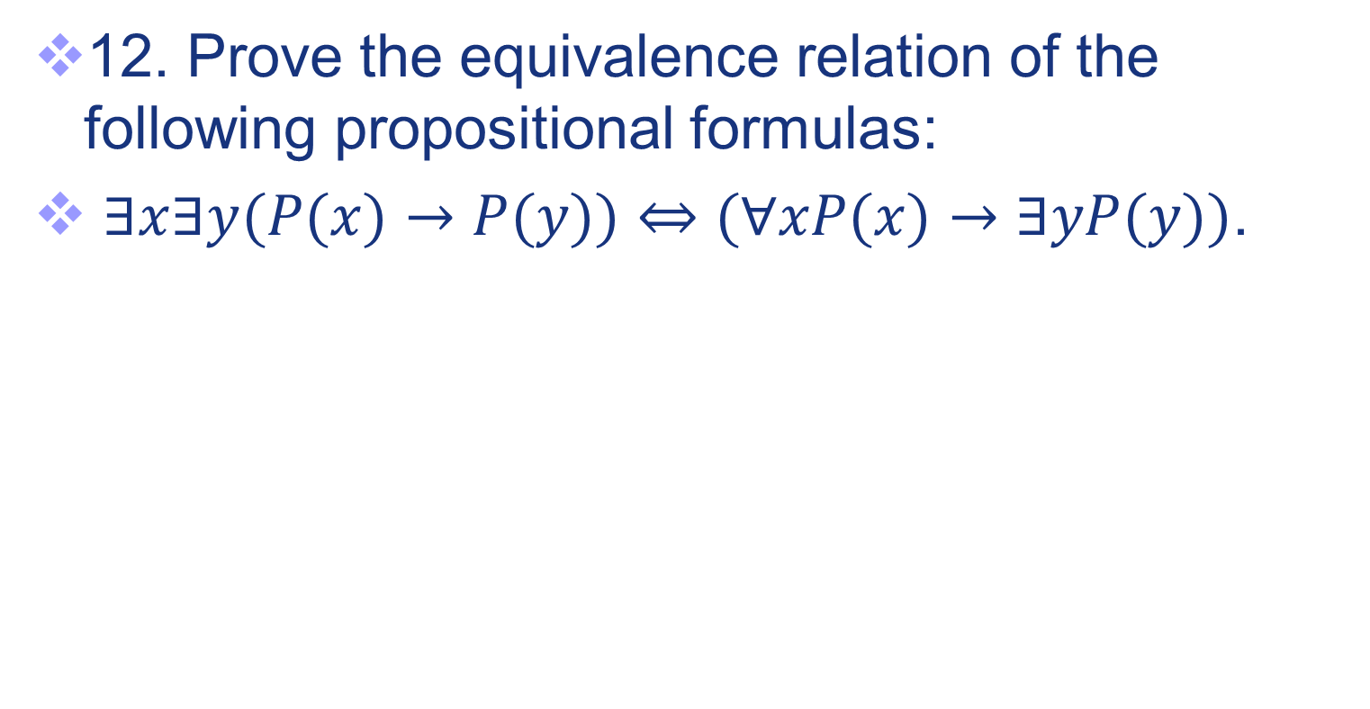
Exercises
9
41

Slide 42
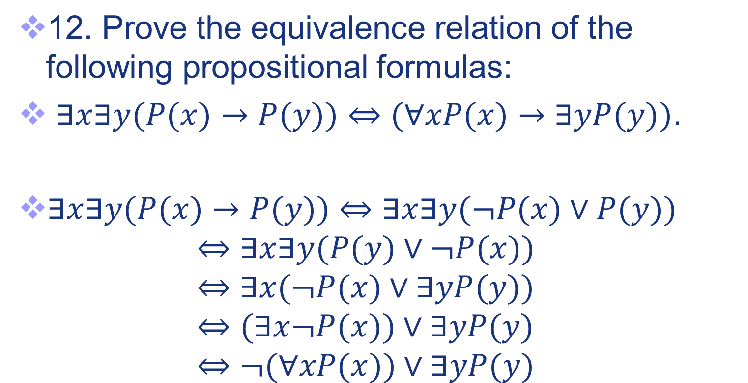
Exercises
9
42

Slide 43
Exercises
10. Find the prenex formulae “quantifiers (expressions)” logically equivalent to the following: [∀xP(x) ∨ ∃yR(y)]→∀xF(x)
43

Slide 44
Exercises
10. Find the prenex formulae “quantifiers (expressions)” logically equivalent to the following: [∀xP(x) ∨ ∃yR(y)]→∀xF(x)
⇔ ¬[∀xP(x) ∨ ∃yR(y)] ∨ ∀xF(x)
⇔ (∃x¬P(x) ∧ ∀ y ¬R(y)) ∨ ∀zF(z)
⇔ ∃x ∀ y ∀z((¬P(x) ∧ ¬R(y)) ∨ F(z))
44

Slide 45
Exercises
11. Prove the equivalence of predicate:
(∀x)(∀y)(P(x)→Q(y))⇔(∃x)P(x)→(∀y)Q(y)
45

Slide 46
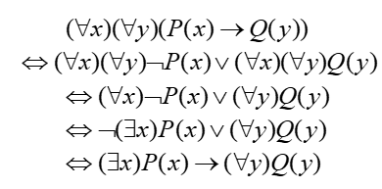
Exercises
11. Prove the equivalence of predicate:
(∀x)(∀y)(P(x)→Q(y))⇔(∃x)P(x)→(∀y)Q(y)
Proof.
46

Slide 47
Exercises
12. The logic expression of the definition of a limit Limx→a f ( x ) = L using quantifiers is: ____
47

Slide 48
Exercises
12. The logic expression of the definition of a limit Limx→a f ( x ) = L using quantifiers is: ____
∀ε>0 ∃δ >0 ∀x >0 (0<|x–a|<δ) → (| f (x)–L|<ε)
48

Slide 49
Exercises
13. Please give the logic expression of the definition of a limit “Limx→a f (x)=L” and its negation “Limx→a f (x)≠L” using quantifiers.
49

Slide 50
Exercises
13. Please give the logic expression of the definition of a limit “Limx→a f (x)=L” and its negation “Limx→a f (x)≠L” using quantifiers.
Limx→a f ( x ) = L
∀ε>0 ∃δ >0 ∀x >0 (0<|x–a|<δ) → (| f (x)–L|<ε)
Limx→a f ( x ) ≠ L
¬∀ε>0 ∃δ >0 ∀x >0 (0<|x–a|<δ) →(|f (x)-L|<ε)
⇔∃ε >0 ∀δ >0 ∃x >0 ¬((0<|x–a|<δ)→(|f (x)-L|<ε))
⇔∃ε >0 ∀δ >0 ∃x >0 ¬(¬(0<|x–a|<δ) ∨(|f (x)-L|<ε))
⇔∃ε >0 ∀δ >0 ∃x >0 (0<|x–a|<δ) ∧ ¬(|f (x)-L|<ε)
⇔∃ε >0 ∀δ >0 ∃x >0 (0<|x–a|<δ) ∧ (|f (x)-L|≥ε)
50

Slide 51
End of the Section 1.4
51
51

